Slide 1

Analytic Test Functions for Generalizable Evaluation of Convex Optimization Techniques
Thomas C. H. Lux, Tyler H. Chang
Department of Computer Science
Virginia Polytechnic Institute and State University

Slide 2
Introduction
Much research is done on the minimization of functions given the ability to evaluate the gradient of the function.
This is primarily used (nowadays) in training neural networks.
There are common data sets that various convex optimization algorithms are tested with by training a neural network to fit the data, however an analytic test suite could be more theoretically and practically useful for testing.

Slide 3
Proposal
This work proposes analytic test functions as well as well-defined transformations to those functions that scale the difficulty in reasonable ways.
This work applies common convex optimization techniques to solving these analytic test functions.
This suite of analytic test functions may be used for general analysis of convex optimization techniques in the future.

Slide 4
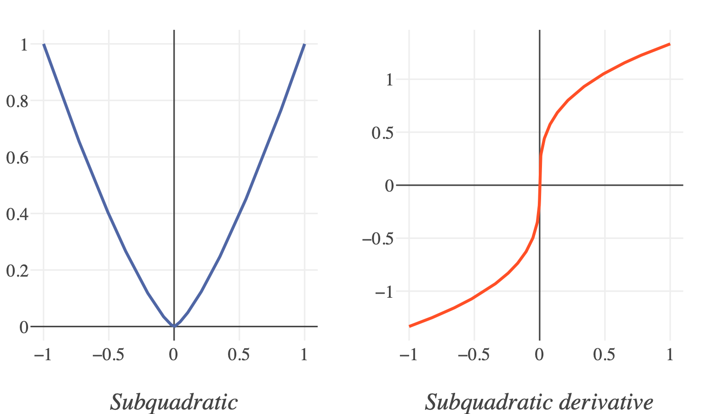
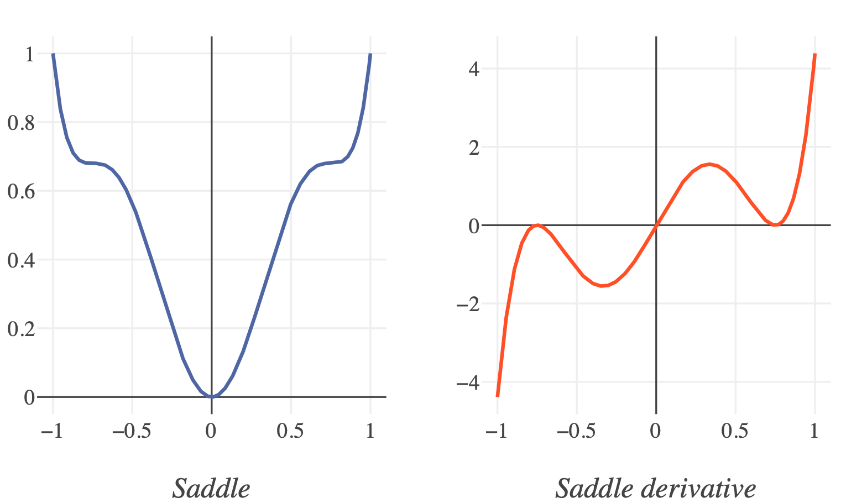
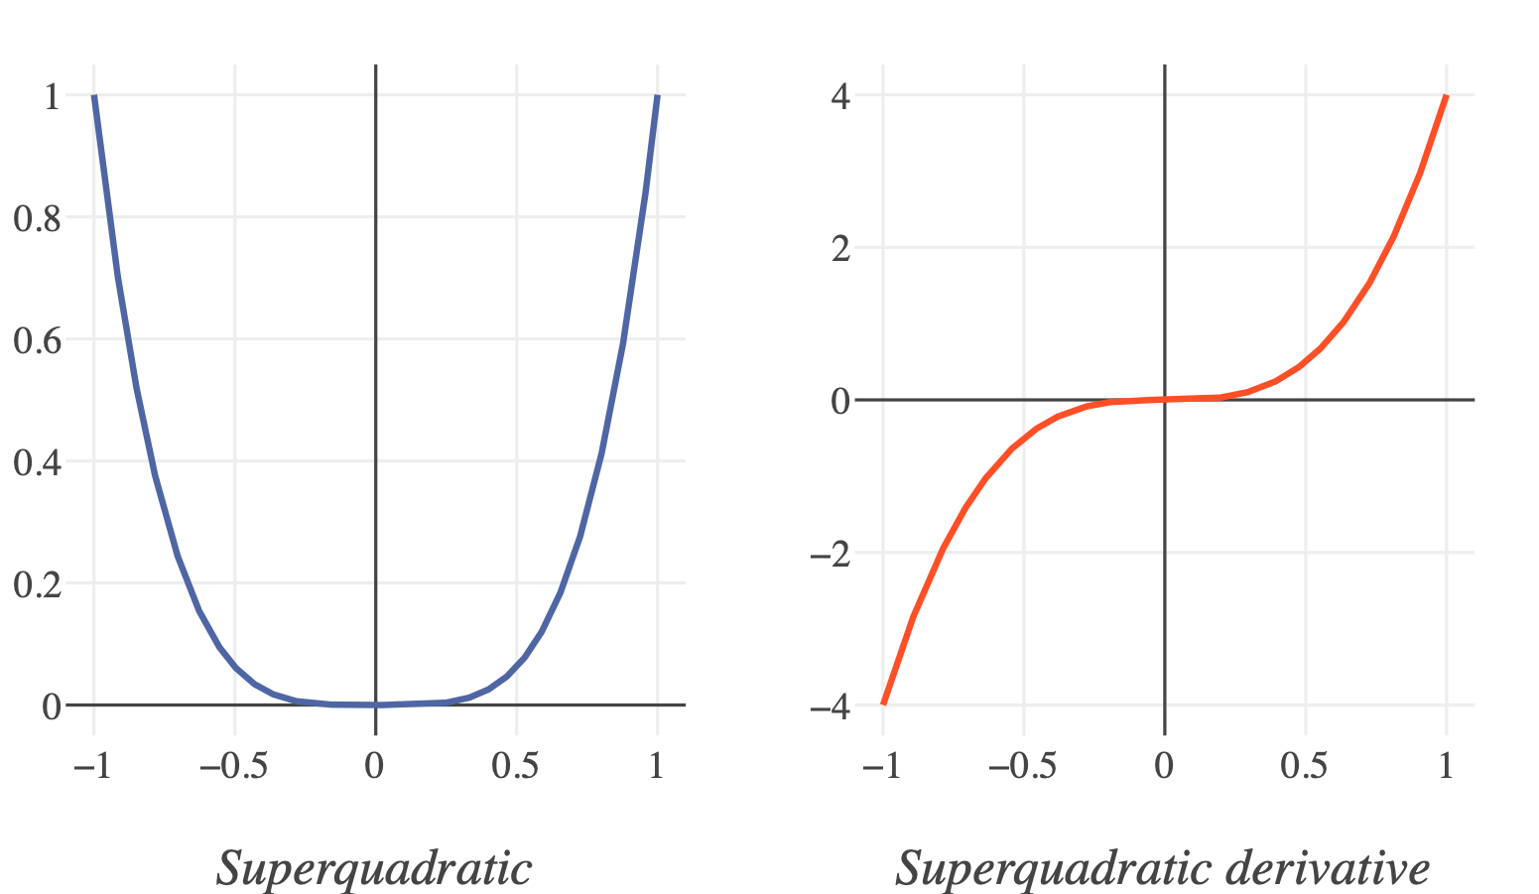
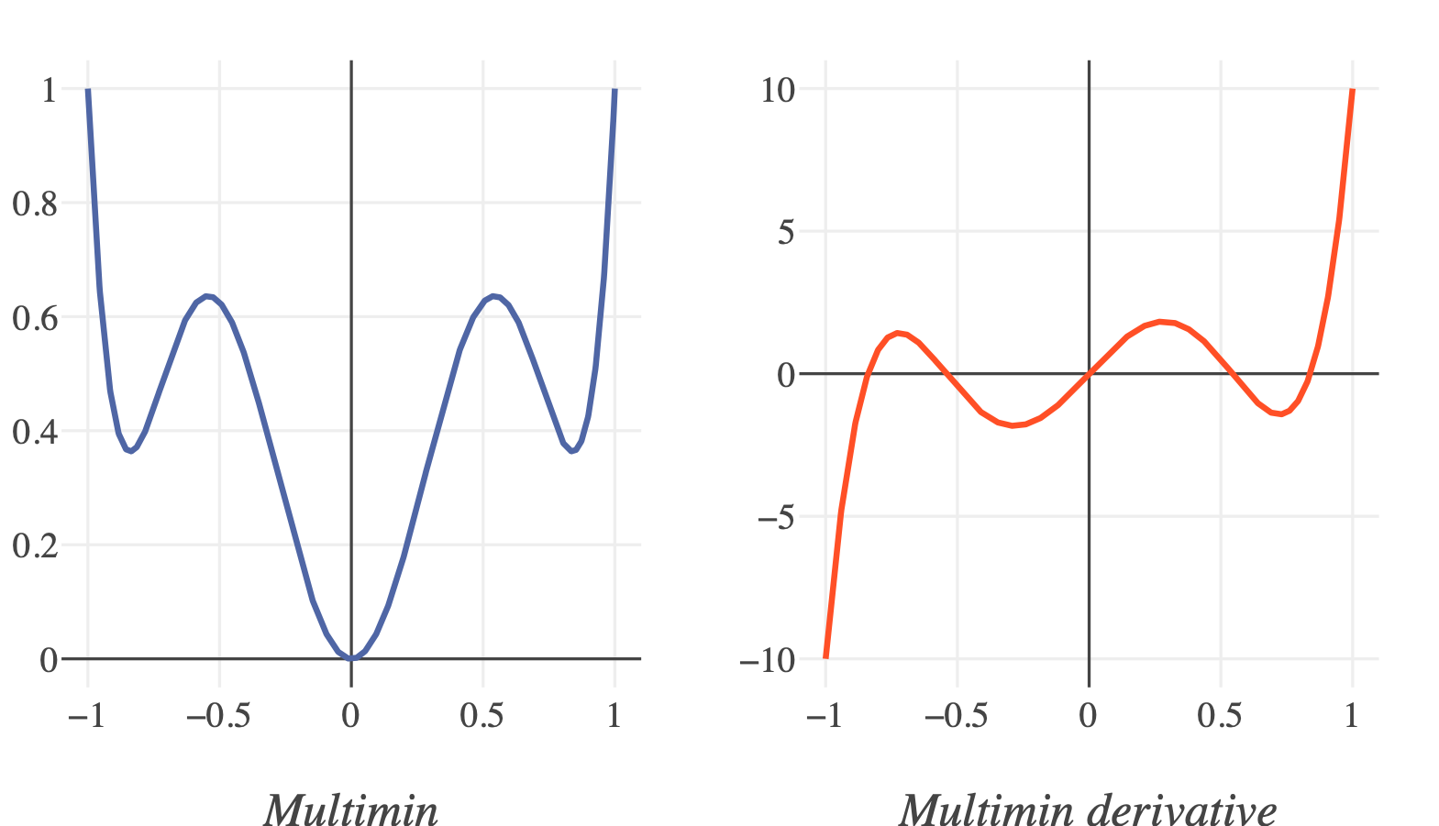
Analytic Test Functions

Slide 5
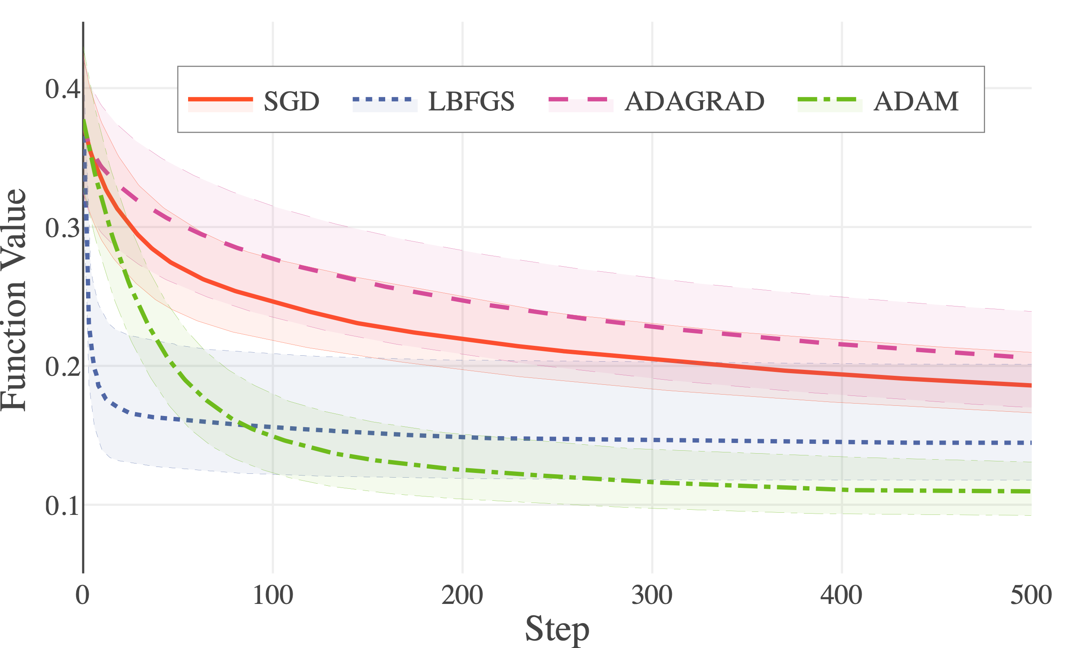
Overall Results, 500 Steps

Slide 6
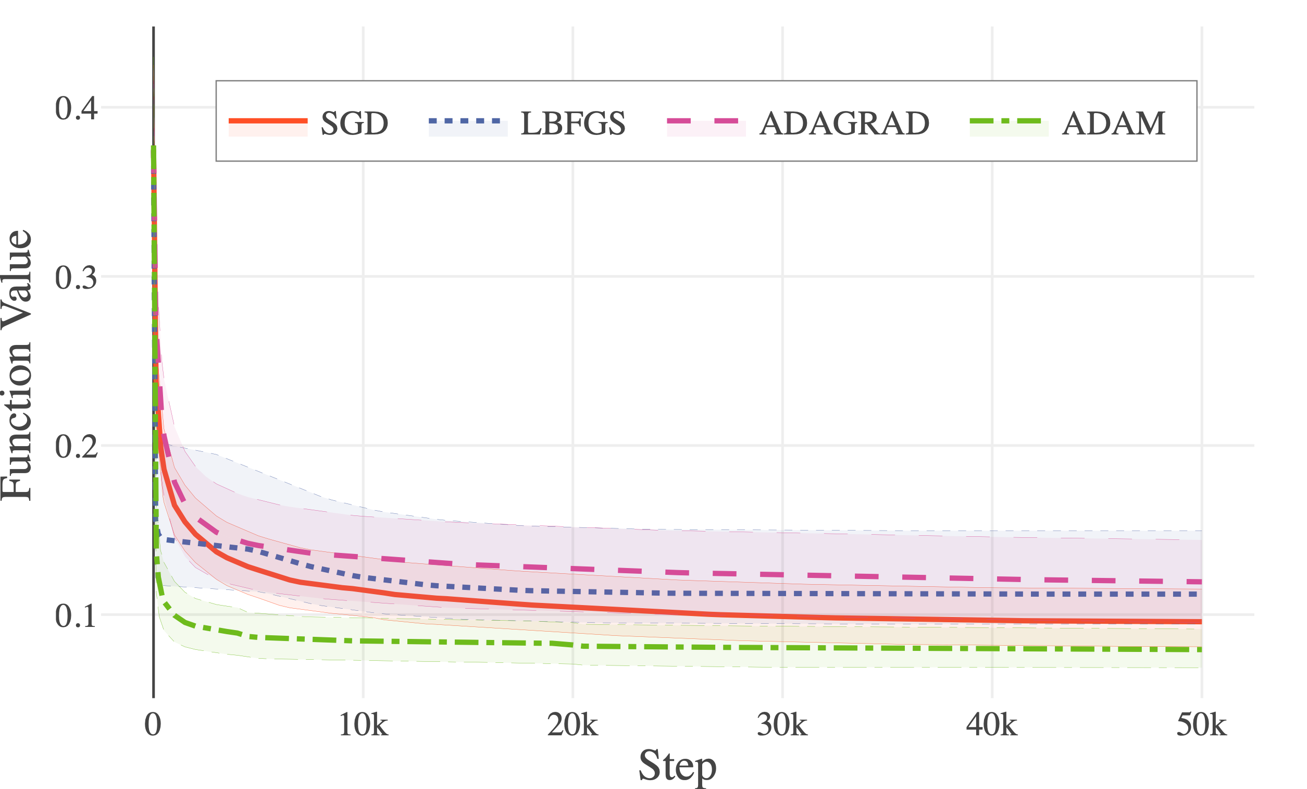
Overall Results, 50K Steps

Slide 7
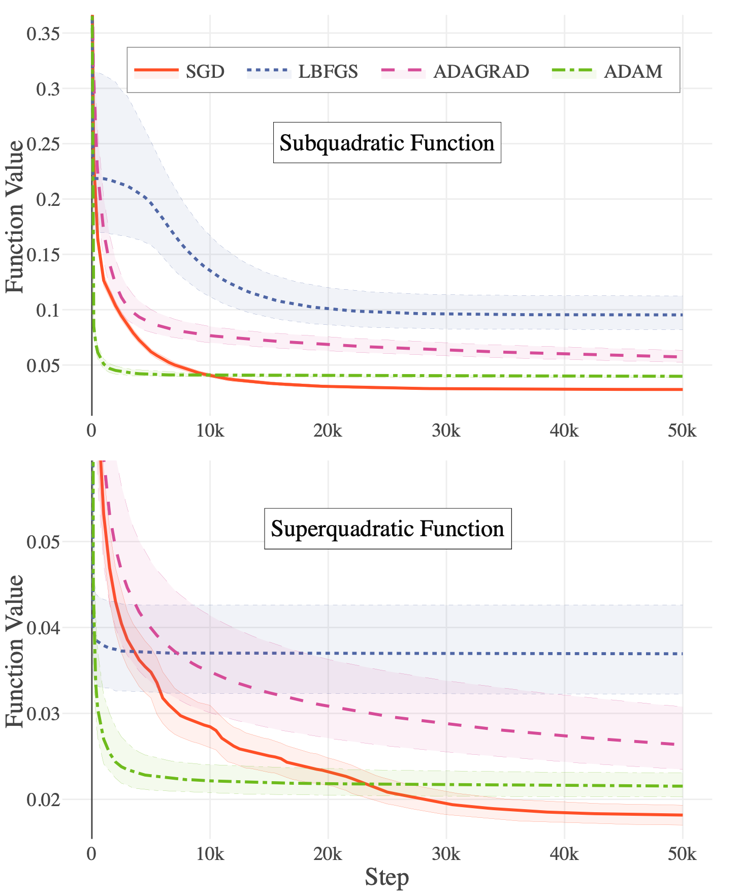
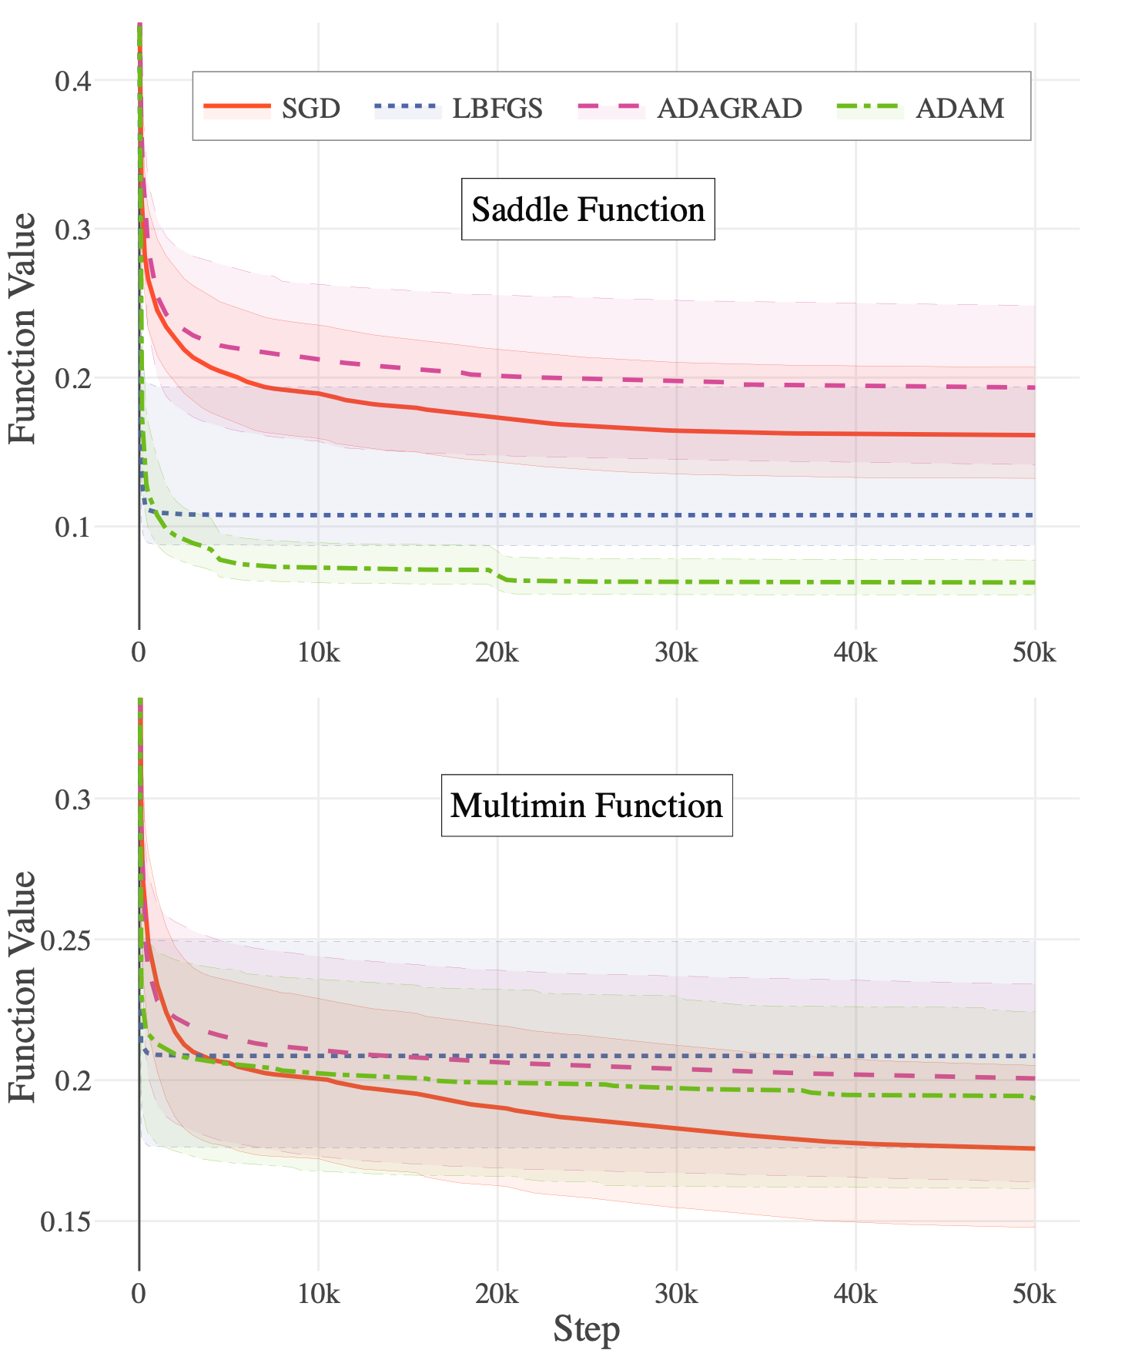
Breakdown by Algorithm

Slide 8
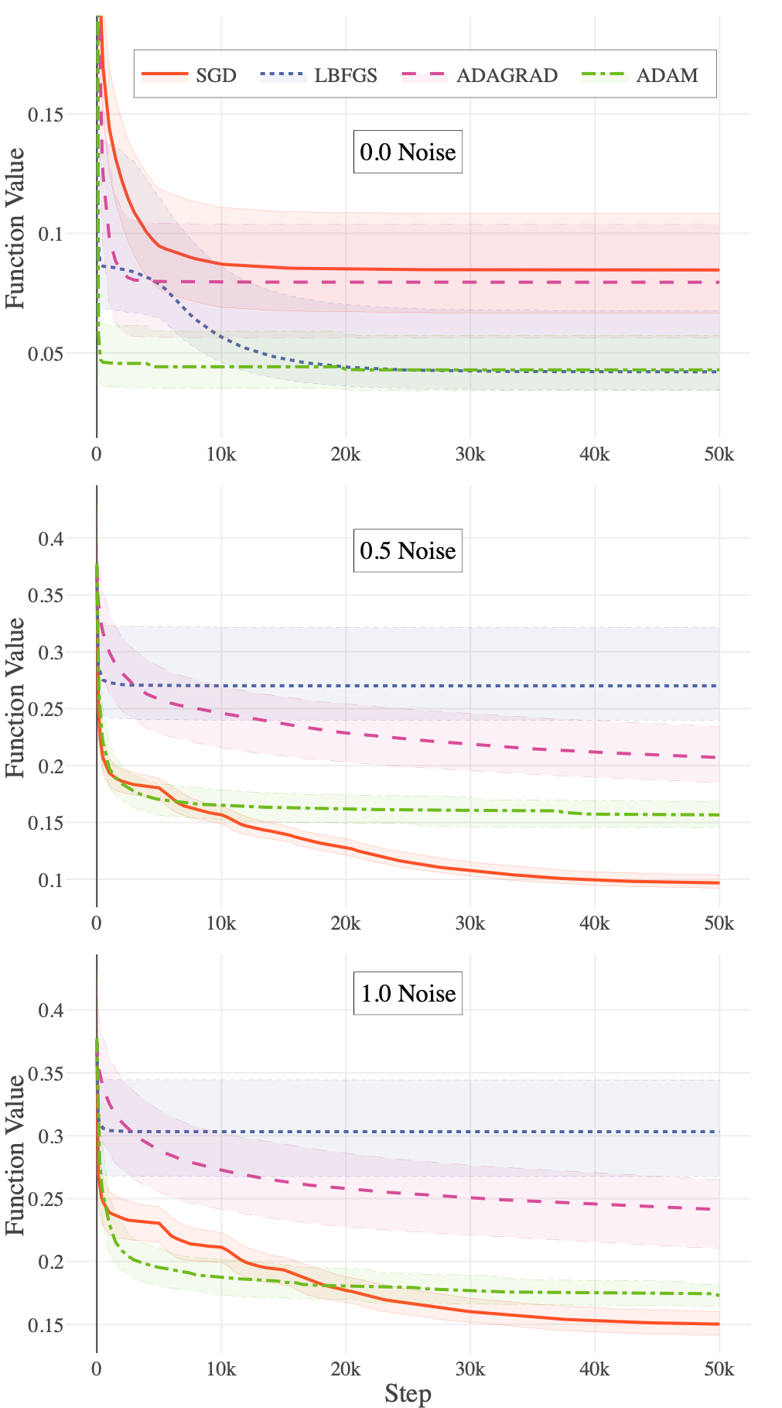
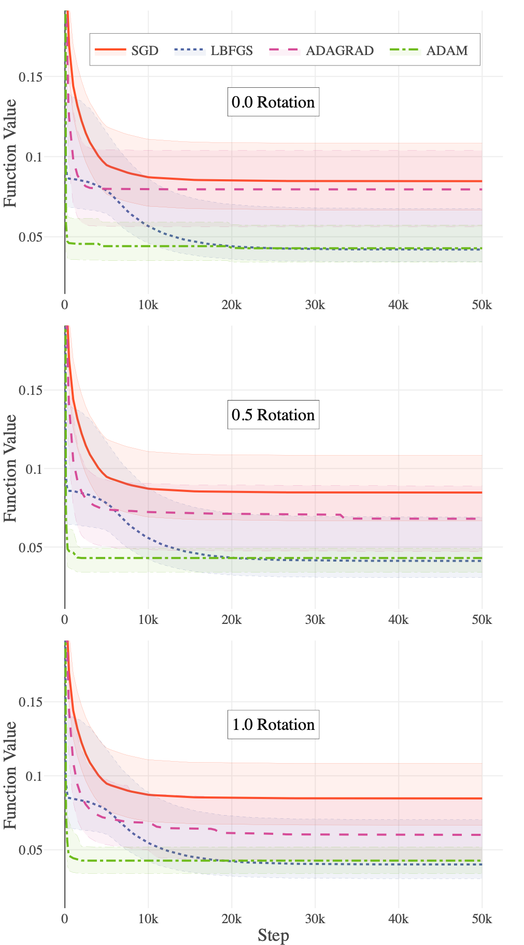
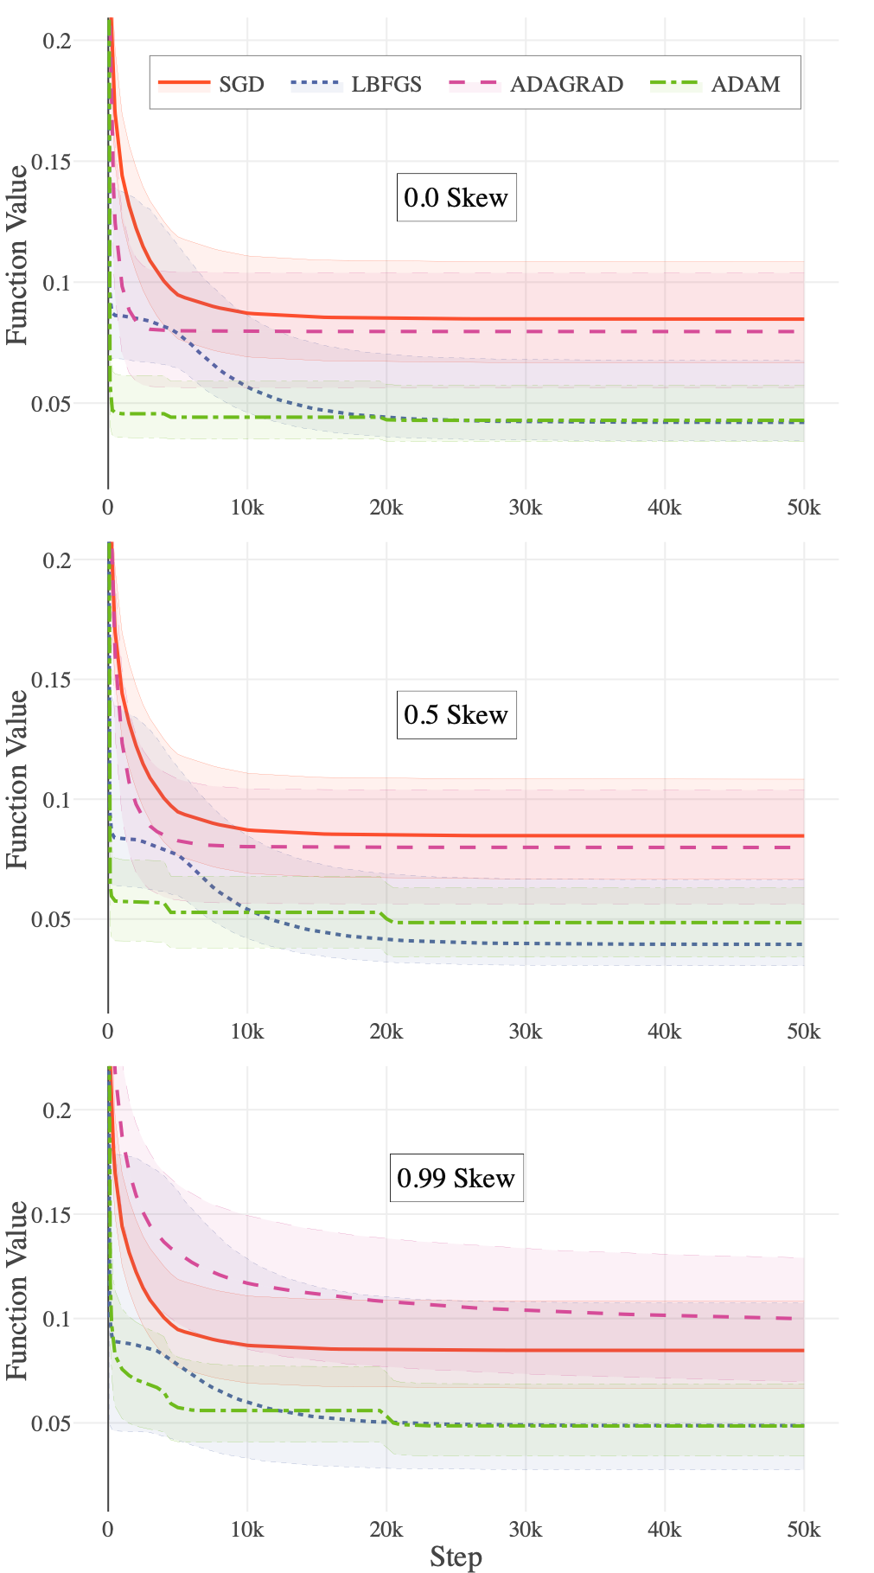
Breakdown by Transformation

Slide 9
Conclusion
Adam is better at solving saddle point problems.
Increased stochasticity appears to favor SGD over other techniques.
Rotation and skew do not appear to negatively affect SGD as much as theory suggests it would.
This suite could be applied to other optimization algorithms in the future, as well as results being compared with other test suites.

